Slide 1


Statistical Modelling with Data
May 23 – June 02, 2023
Instructor: Qing (Leah) Li, Ph.D. Candidate at Cumming School of Medicine
qing.li2@uclagary.ca
Thank you Dr. Thuntida Ngamkham for contributing the contents
Thank you Dr. Qingrun Zhang and Dr. Quan Long for contributing some slides

Slide 2
Statistical Modelling with Data
Topic 1: Statistical Modelling
Lecture 1: First-order models with quantitative independent variables
Topic 2: Statistical Modelling with interactions (Assignment 1)
Lecture 2: Interaction effects, quantitative and qualitative variables
Lecture 3: Interaction effects and second-order models
Topic 3: Statistical Model selection (Assignment 2)
Lecture 4: Model selection: Stepwise regression, Forward selection and Backward Elimination
Lecture 5: Model selection: Evaluate the reliability of the model chosen
Topic 4: Statistical model diagnostics
Lecture 6: Multiple regression diagnostics: verify linearity, independence, equal variance assumptions and normality assumptions.
Lecture 7: Multiple regression diagnostics: identify multicollinearity and outliers and data transformation.
Topic 5: Transfer learning
Lecture 8: Deep learning basics
Lecture 9: Transfer-learning (Bonus): standing on the shoulders of giants.

Slide 3
Statistical Modelling with Data
Topic 1: Statistical Modelling
Lecture 1: First-order models with quantitative independent variables
Topic 2: Statistical Modelling with interactions (Assignment 1)
Lecture 2: Interaction effects, quantitative and qualitative variables
Lecture 3: Interaction effects and second-order models
Topic 3: Statistical Model selection (Assignment 2)
Lecture 4: Model selection: Stepwise regression, Forward selection and Backward Elimination
Lecture 5: Model selection: Evaluate the reliability of the model chosen
Topic 4: Statistical model diagnostics
Lecture 6: Multiple regression diagnostics: verify linearity, independence, equal variance assumptions, and normality assumptions.
Lecture 7: Multiple regression diagnostics: identify multicollinearity and outliers and data transformation.
Topic 5: Transfer learning
Lecture 8: Deep learning basics
Lecture 9: Deep learning advances: Transfer-learning (Bonus).

Slide 4
Statistical Modelling with Data
Learning Outcomes: At the end of the course, participants will be able to
Model the multiple linear relationships between a response variable (Y) and all explanatory variables (both categorical and numerical variables) with interaction terms. Interpret model parameter estimates, construct confidence intervals for regression coefficients, evaluate model fits, and visualize correlations between a response variable (Y) and all explanatory variables (X) by graphs (scatter plot, residual plot) to assess model validity.
Predict the response variable at a certain level of the explanatory variables once the fit model exists.
Implement R-software and analyze statistical results for biomedical and other data.
Evaluations
Assignments will be posted on Slack (our communication tool with students).
Students must attend 70% (6/9) of the sessions in order to receive the certificate and are encouraged to work on the assignments progressively throughout the course as the relevant material is covered.

Slide 5

Statistical Modelling with Data
Supportive materials
Lectures slides (2023)
R code scripts (2023)
PDF (dated 2022)
Two Assignments (dated 2022)
Slack channels
Recoding videos
Exercises
Course-documents

Slide 6

Lecture 7: Multiple regression diagnostics: identify multicollinearity and outliers, apply data transformation

Slide 7
Plots
R: plot()
Pros:
Easy to write and learn by heart
Cons:
Does not incorporate advanced functions such as fitting curves to points
Multiple figures in one panel
par(mfrow=c(nrow, ncol))
ggplot2 package: ggplot()
Pros:
Multiple choices, high-level functions
Cons:
It takes a while to understand and learn the functions by heart
Multiple figures in one panel
library(gridExtra)
grid.arrange(p1,p2, nrow = 3,top = “Title").

Slide 8
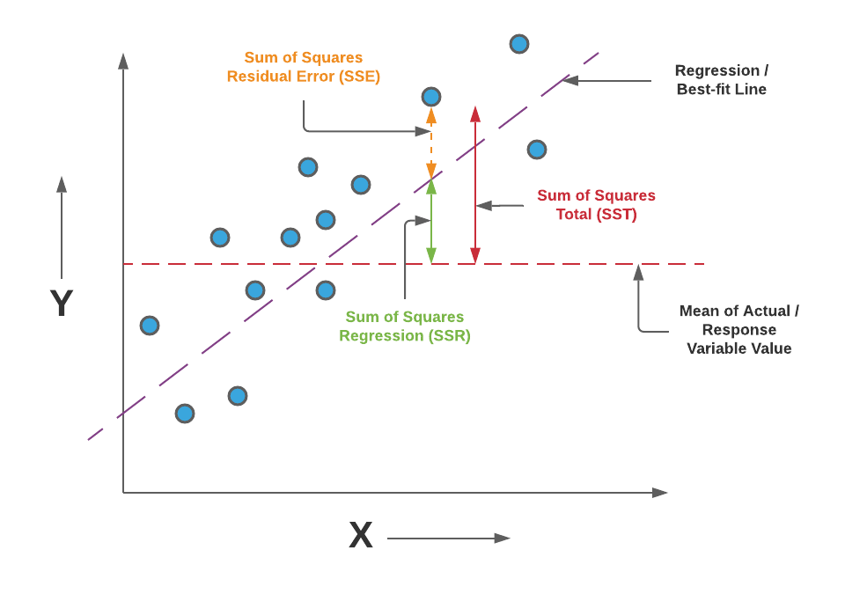
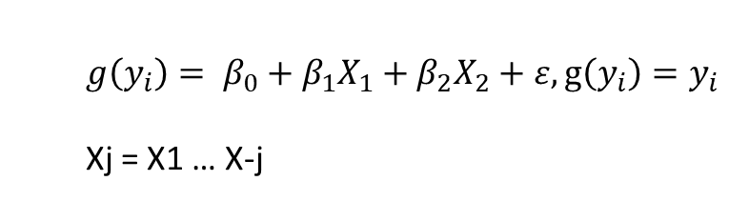
Assumptions
response, coefficients of correlation, predictors
$$g\left(y_{i}\right)= β_{0}+β_{1}X_{1}+β_{2}X_{2}+ε, g\left(y_{i}\right)=y_{i}$$
Xj = X1 … X-j
Linearity Assumption
Relationships between all predictors and the response are linear
Independence Assumption
Independence of observations
Equal Variance Assumption
Error term (Residuals) has equal variance given any values of independent variables
Normality Assumption
Error term (Residuals) is normally distributed
Multicollinearity
No perfect collinearity and non-zero variance of independent variables
Outlier
Error terms (Residuals) has expected value of zero given the values of independent variables

Slide 9
5. Multicollinearity
Often, two or more of the independent variables used in the model for E(Y) provide redundant information. That is, the independent variables will be correlated with each other. When the independent variables are (linearly) correlated, we say that multicollinearity exists. In practice, it is common to observe correlations among the independent variables. However, a few problems arise when serious multicollinearity is present in the regression analysis.
What Problems Do Multicollinearity Cause?
The coefficient estimates can swing wildly based on which other independent variables are in the model. The coefficients become very sensitive to small changes in the model.
Multicollinearity reduces the precision of the estimate coefficients, which weakens the statistical power of your regression model. You might not be able to trust the p-values to identify independent variables that are statistically significant.

Slide 10
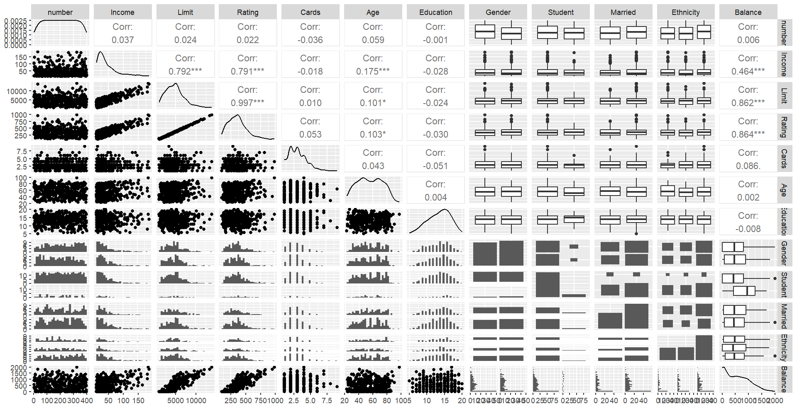
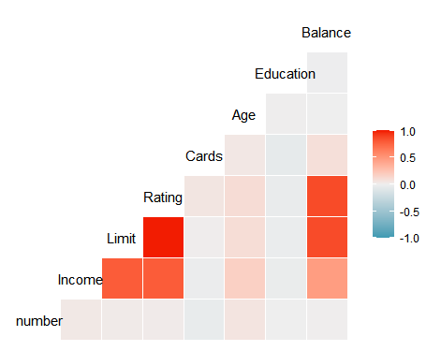
An example from credit data
ggpairs(credit) ggcorr(credit)

Slide 11
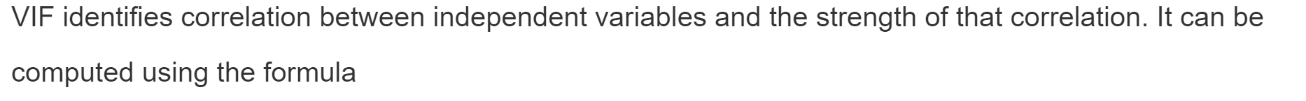
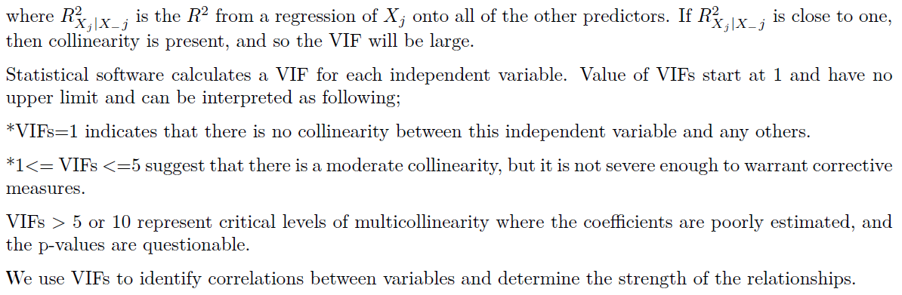
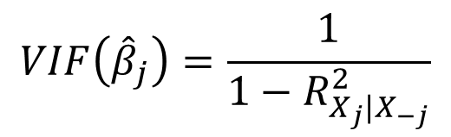
Testing for Multicollinearity with Variance Inflation Factors (VIF)
Attention: When the high VIFs are caused by the inclusion of powers or products of other variables, you can Safely Ignore Multicollinearity
$$VIF\left({\hat{β}}_{j}\right)=\frac{1}{1−R_{X_{j}|X_{−j}}^{2}}$$
library(mctest)
>>imcdiag(model, method=“VIF”)
library(car)
>>VIF(model)

Slide 12
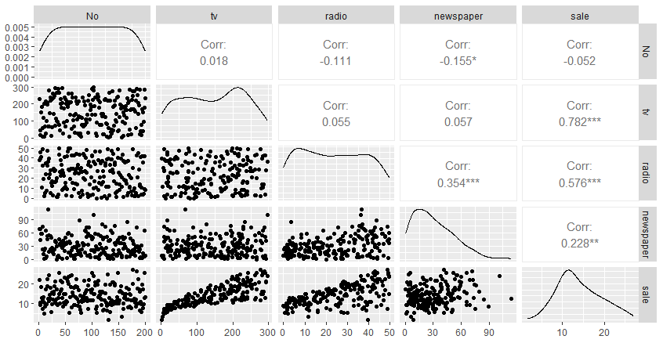
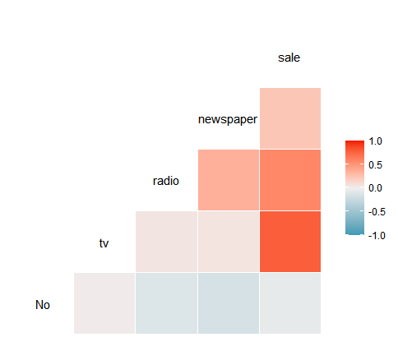
An example from Advertising data

Slide 13
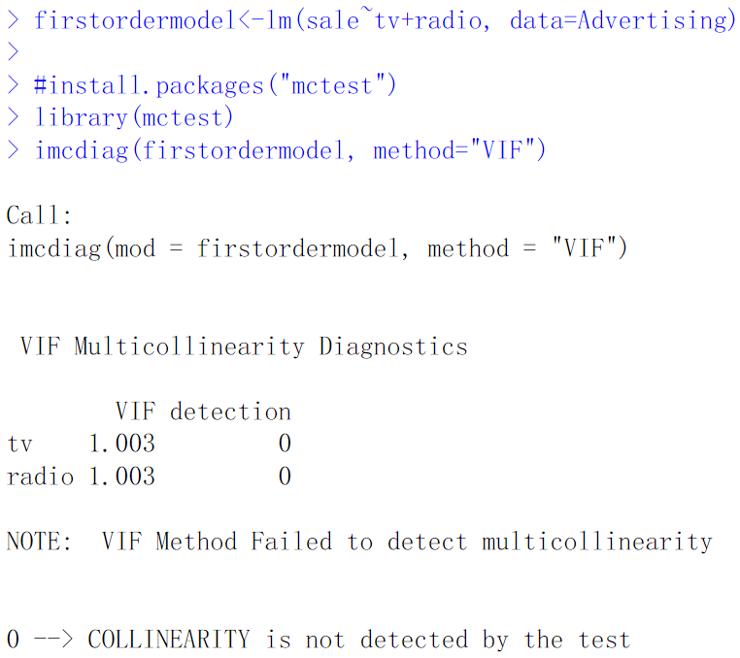
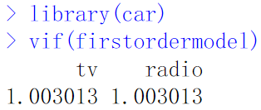
An example from Advertising data
From the output, you can see that the V IFTV = V IFRadio=1.003013, which suggests that there is no
correlation between these predictors.

Slide 14
Solutions for Multicollinearity
The first solution is to drop one of the problematic variables from the regression model. This can usually be done without much compromise to the regression model, since the presence of multicollinearity implies that the information that this variable provides about the response is redundant in the presence of the other variables.
The second solution is to combine the collinear variables together into a single predictor. For instance, we might take the average of standardized versions of Limit and Rating in order to create a new variable that measures credit worthiness.

Slide 15


In class Practice Problem 19
Use the CREDIT.CSV data.
From the credit card example, check whether multicollinearity exists or not.
Lecture_7.R
15

Slide 16
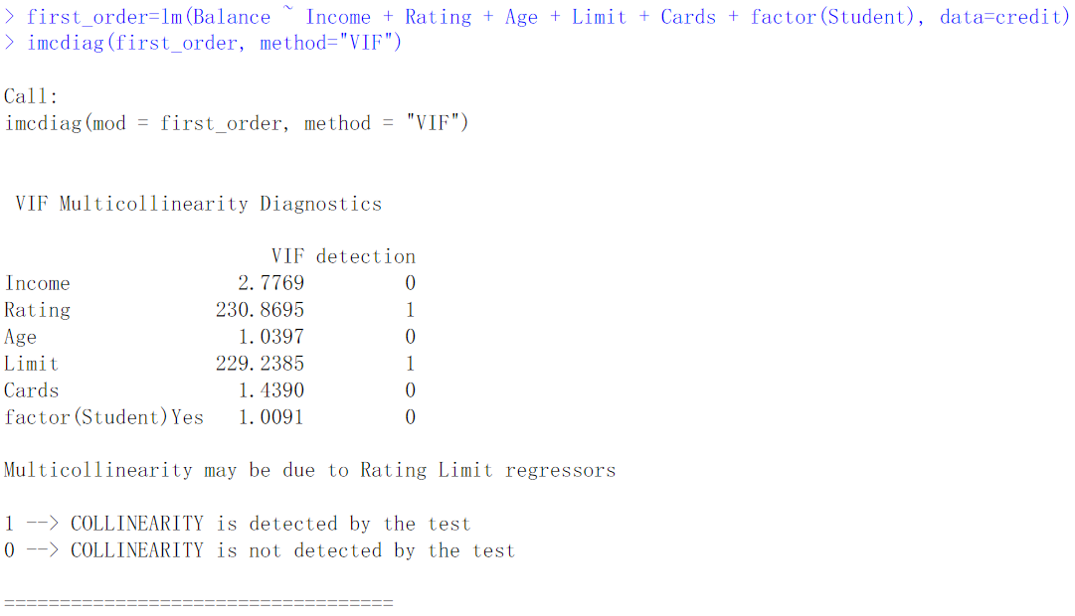
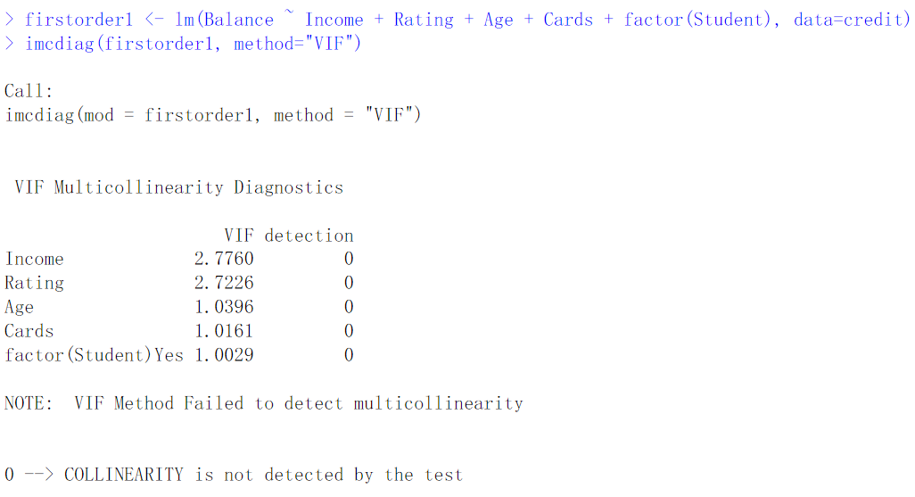
In class Practice Problem 19 Answers
Lecture_7.R
16

Slide 17

In class Practice Problem 20
From the clerical staff work hours, check whether multicollinearity exists in the optimal models or not. If you detect a trend, how would you like to transform the predictors in the model?
Lecture_7.R
17

Slide 18
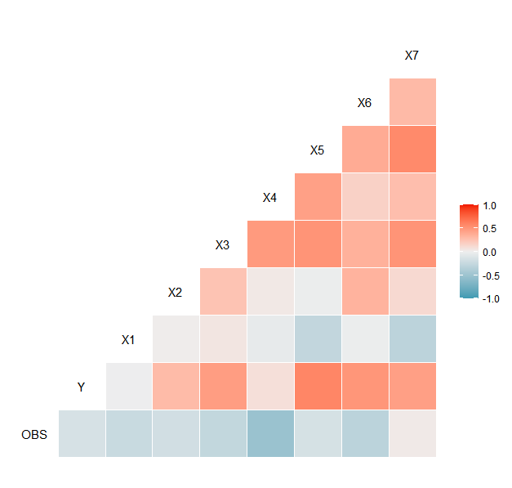
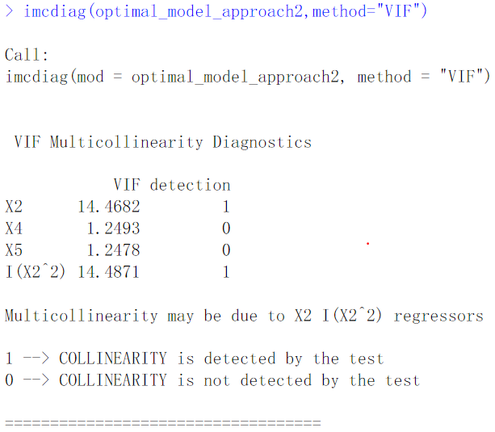
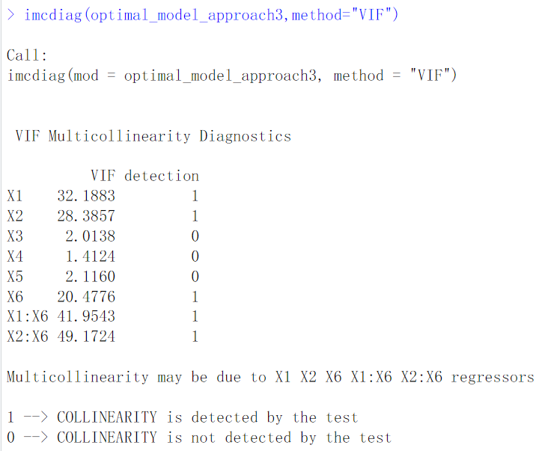
In class Practice Problem 20 Answers
optimal_model_approach3 <-lm(Y~(X1+X2+X3+X4+X5+X6+X1:X6+X2:X6), data=workhours)
optimal_model_approach2=lm(Y ~ X2+X4+X5+I(X2^2), data=workhours)
Lecture_7.R
18

Slide 19
6. Outlier (The effect on individual cases)
Outlier: An outlying case is defined as a particular observation (𝑌,𝑋1,𝑋2,...𝑋𝑝) that differs from the majority of the cases in the data set. Potentially caused by a different mechanism (something might wrong)
Possible causes of outliers
Error in recording data (e.g. 28 to 82)
Measurement process/tool problem
Failure of the experimental process
For non-robust statistics, outlier can ruin the analysis. (e.g. mean)
19

Slide 20
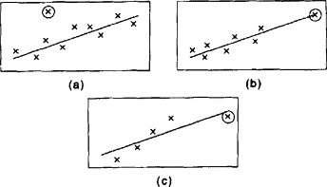
Several key concepts
Outliers: a point that falls far from the other data points.
Leverage: leverage is a measure of how far away the independent variable values of an observation are from those of the other observations. High-leverage points, if any, are outliers with respect to the independent variables.
Good leverage, low I
Influential: If the coefficients of predictors change dramatically when a point is removed, that point is influential. How influential a point is, is a combination of how much leverage it has and how extreme it is in the y-direction.
Bad leverage, high influential
Outliers
Leverage
Influential
20
Notes:
Consider this scatterplot, where we have this outlier which falls far from the pattern made by the other observations.
It would show up as having a large residual value because the observed value falls so much higher than the regression line. Every data point tries to pull the line toward itself. Some do it more successfully than others.

Slide 21
Leverage & influence
Low leverage, some Influential
High leverage, high Influential
High leverage, low Influential
What to do with influential point?
Make sure the observation is correctly recorded. Can we get more observations near that value of X? Do the conclusions change?
21

Slide 22
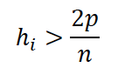
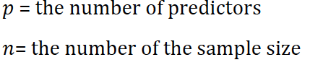
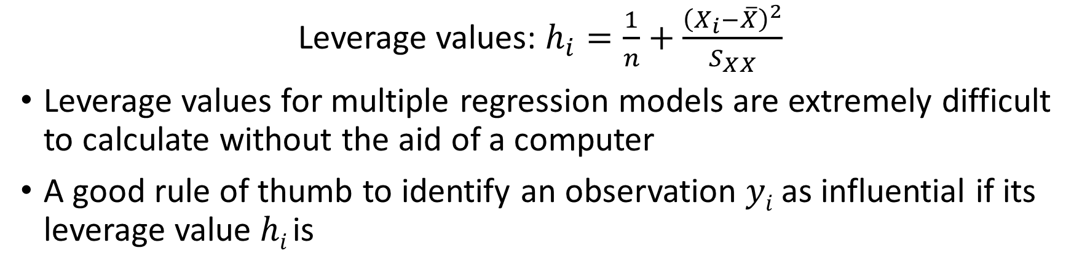
Numeric measures for leverage
Leverage values: $h_{i}=\frac{1}{n}+\frac{{\left(X_{i}−\overline{X}\right)}^{2}}{S_{XX}}$
Leverage values for multiple regression models are extremely difficult to calculate without the aid of a computer
A good rule of thumb to identify an observation 𝑦_{𝑖} as influential if its leverage value ℎ_{𝑖} is
22

Slide 23
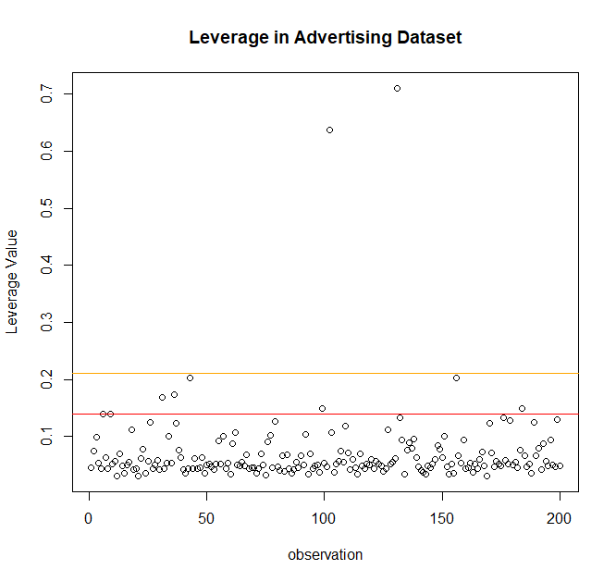
Numeric measures for leverage
lev=hatvalues(morepower)
p = length(coef(morepower))
n = nrow(Advertising)
outlier2p = lev[lev>(2*p/n)]
outlier3p = lev[lev>(3*p/n)]
plot(rownames(Advertising),lev, main = "Leverage in Advertising Dataset", xlab="observation", ylab = "Leverage Value")
abline(h = 2 *p/n, lty = 1)
abline(h = 3 *p/n, lty = 1)

Slide 24
Effects of influential points
Not all outliers are influential in linear regression analysis (whatever outliers mean). Even though data have extreme values, they might not be influential to determine a regression line. That means, the results wouldn’t be much different if we either include or exclude them from analysis. They follow the trend in the majority of cases and they don’t really matter; they are not influential.
On the other hand, some cases could be very influential even if they look to be within a reasonable range of the values. They could be extreme cases against a regression line and can alter the results if we exclude them from analysis. Another way to put it is that they don’t get along with the trend in the majority of the cases.

Slide 25
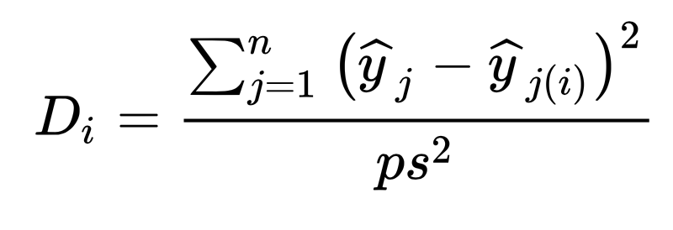
Numeric measure for influence
A measure of the overall influence an outlying observation has on the estimated coefficients was proposed by R. D. Cook (1979). Cook’s Distance:
S is the mean square error of the regression model. p is the number of the parameters in the model
25

Slide 26
Cook’s Distance
The Cook’s distance 𝐷_{𝑖} measures the effect of deleting a given observation.
A large value of 𝐷_{𝑖} indicates that the observed 𝑌_{𝑖} value has strong influence on the estimated coefficients
A general rule of thumb is that observations with a Cook’s 𝐷 of more than 3 times the mean, 𝜇, is a possible outlier.
An alternative interpretation is to investigate any point over 4/𝑛, where 𝑛 is the number of observations
Any point with large 𝐷_{𝑖} . The consensus seems to be that a 𝐷_{𝑖} value of more that 1 indicates an influential value, but you may want to look at values above 0.5.
26

Slide 27
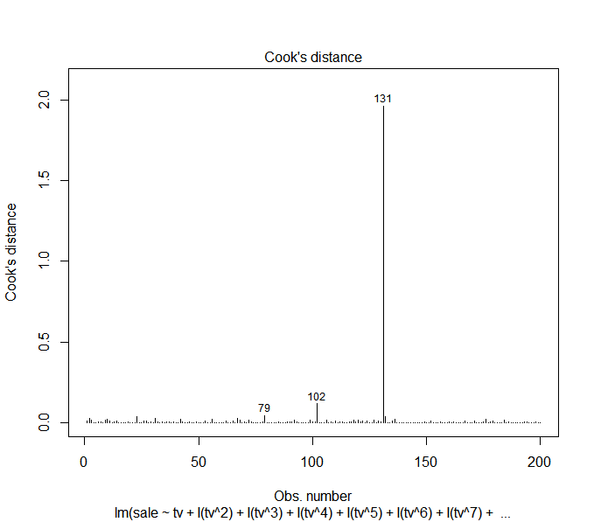
Identification of influential points for Advertising data
plot(highorder11, which=4)

Slide 28
Which()
plot(model, which=n)
Which selects which plot (n) to be displayed:
A plot of residuals against fitted values. [Linearity]
A normal Q-Q plot. [Normality ]
A Scale-Location plot of sqrt(|residuals|) against fitted values. [Equal variance]
A plot of Cook's distances versus row labels.
A plot of residuals against leverages. [Outlier]
A plot of Cook's distances against leverage/(1-leverage)
28

Slide 29
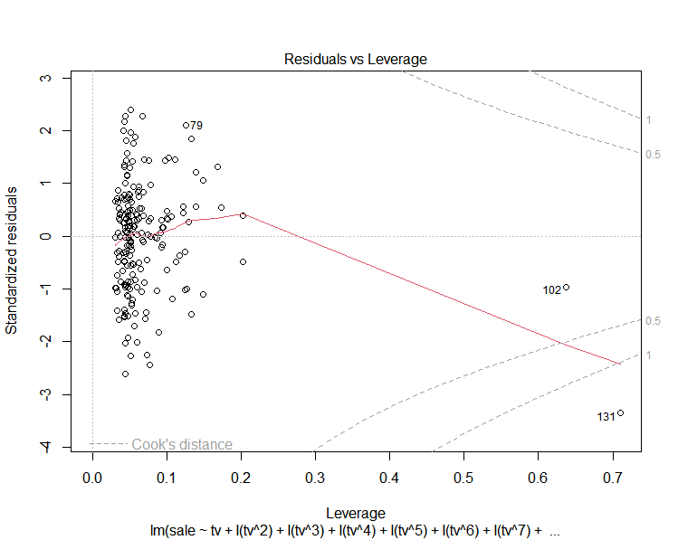
Identification of high influential and high leverage points for Advertising data
Residual VS leverage plot helps the identification of influential points
Advertising=read.table("Advertising.txt", header = TRUE, sep ="\t" )
Highorder11=lm(sale~tv+I(tv^2)+I(tv^3)+I(tv^4)+I(tv^5)+I(tv^6)+I(tv^7)+I(tv^8)+I(tv^9)+I(tv^10)+I(tv^11)+radio+tv*radio, data=Advertising)
plot(highorder11,which=5)

Slide 30
What to do with outlier
For a good understanding of the regression model, if we have some outliers or influential points, we may want to
See what happens when we exclude these from the model as an outlier has occurred due to an error in data collection or recoding, then the solution is to simply remove the observation.
Investigate these cases separately as it may happen that we mistyped.
30

Slide 31
In class Practice Problem 21
From the clerical staff work hours, using residual plots to conduct a residual analysis of the data. Check any potential outliers.
optimal_model_approach2=lm(Y ~ X2+X4+X5+I(X2^2), data=workhours)
optimal_model_approach3 <-lm(Y~(X1+X2+X3+X4+X5+X6+X1:X6+X2:X6), data=workhours)
Lecture_7.R
31

Slide 32

In class Practice Problem 22
Use the Exective.CSV data.
Check assumptions for the model below to predict executive salary (Y)
$$Y=β_{0}+β_{1}X_{1}+β_{2}X_{1}^{2}+{β_{3}X}_{2}+β_{4}X_{3}+β_{5}X_{1}+β_{6}X_{5}+β_{7}X_{3}∗X_{4}+ε$$
Lecture_7.R
32

Slide 33

Coffee break
15:00

Slide 34
Transformation

Slide 35
What is data transformation
Data transformation is the process of changing the format, structure, or value of data
Transformation is used to transform nonnormal data to normal data
Transformation is done by using many functions such as square root, logarithm, power, reciprocal or arcsine, etc.

Slide 36
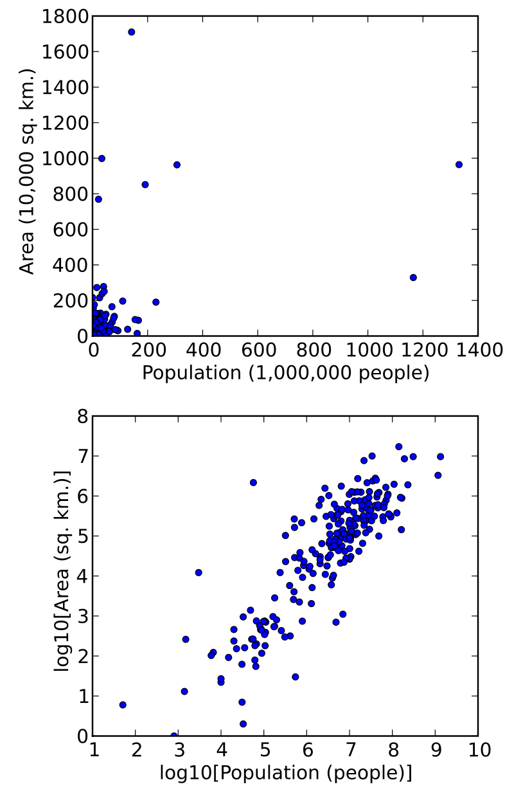
Motivation of transformation
One of the most common assumptions for statistical analyses is that of normality (normality of error terms)
To make interpterion of the data easier
To make appearance of the graphs easier to understand
A scatterplot in which the areas of the sovereign states and dependent territories in the world are plotted on the vertical axis against their populations on the horizontal axis. The upper plot uses raw data. In the lower plot, both the area and population data have been transformed using the logarithm function.
https://en.wikipedia.org/wiki/Data_transformation_%28statistics%29

Slide 37
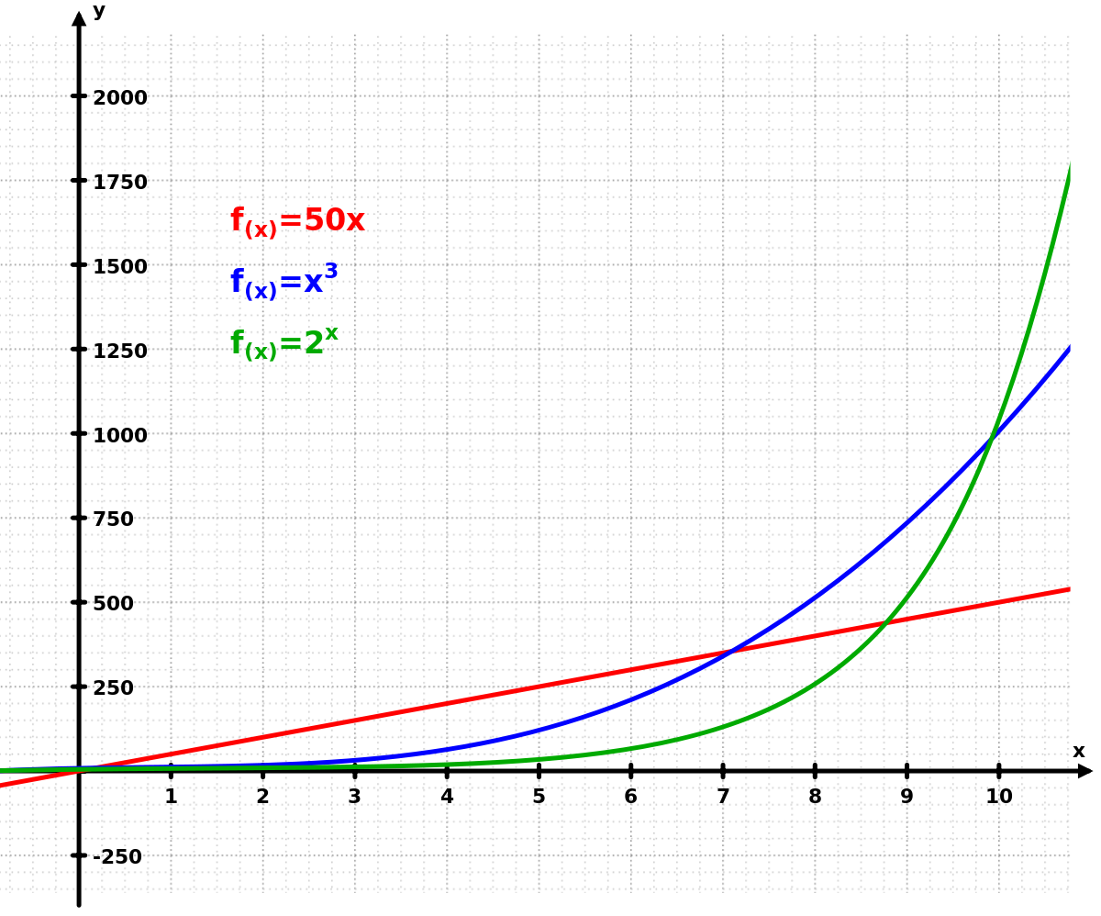
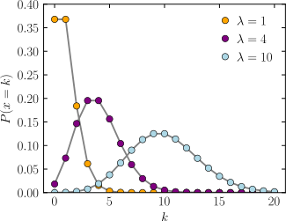
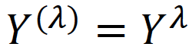
Transformations
Exponential OR Power of x
Logarithm transformation: If y goes exponentially or as a power of x, transform by taking the log
Square root transformation: If data exhibiting a Poisson distribution (variance =mean), transform by taking the square root.
Box-Cox transformation: a family of power transformation.
where 𝜆 is a parameter to be determined using the data, vairies from -5 to 5
Poisson distribution
37

Slide 38
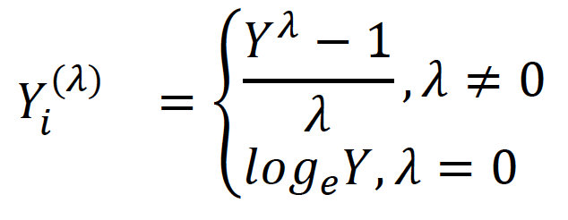
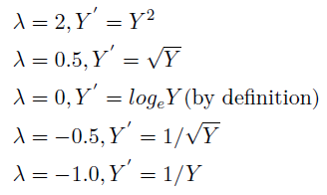
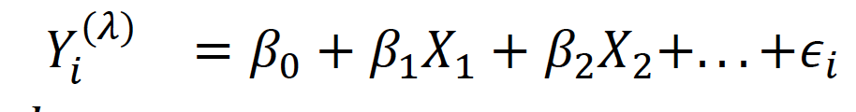
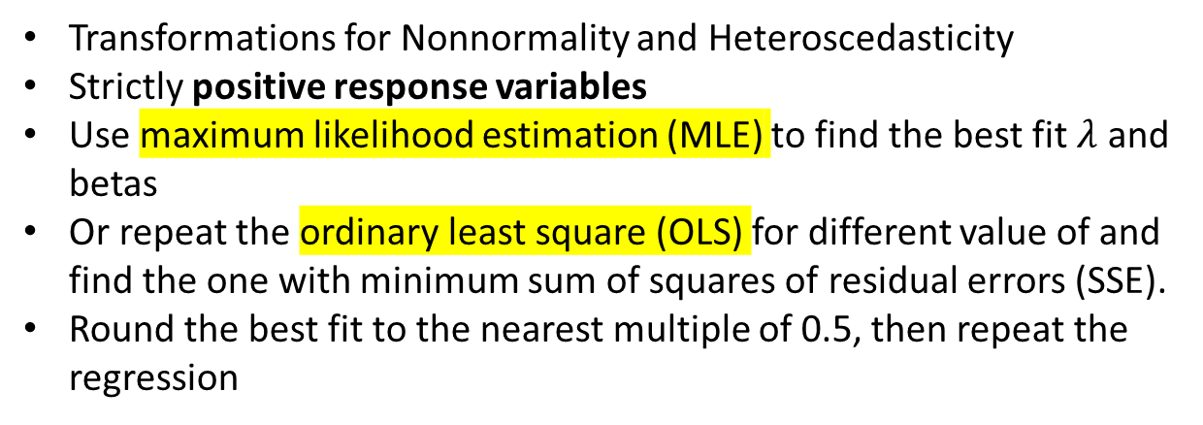
Box-Cox Transformation
Transformations for Nonnormality and Heteroscedasticity
Strictly positive response variables
Use maximum likelihood estimation (MLE) to find the best fit $λ$ and betas
Or repeat the ordinary least square (OLS) for different value of and find the one with minimum sum of squares of residual errors (SSE).
Round the best fit to the nearest multiple of 0.5, then repeat the regression
38
Notes:
It is often difficult to determine which transformation on response variable (Y) to use, the Box-Cox method consider a family of power transformations on strictly positive response variables (all data is positive and greater than 0) such that Y (λ) = Y λ, where λ is a parameter to be determined using the data, varies
from -5 to 5. Note that this family encompasses the following simple transformations:

Slide 39
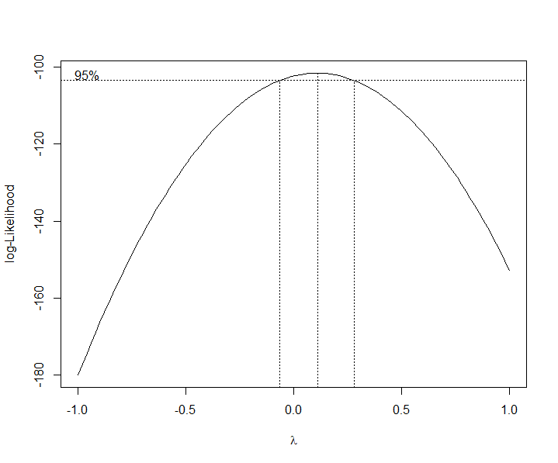
Best lambda for Box-Cox Transformation
library(MASS)
bc=boxcox(reg,lambda=seq(-1,1))
bestlambda=bc$x[which(bc$y==max(bc$y))]
bestlambda

Slide 40
Example 1 for Box-Cox transformation
A practical question for the head of a university could be how study fees (stfees) raise the universities net assets (nassets).A simple linear regression could help to explain the relation between these two variables.
Hints: Use library(Ecdat) to load University dataset

Slide 41
Example 1 for Box-Cox transformation
Check assumptions | Results
Linearity | Failed
Independence | Pass
Equal variance (no hetero) | P=0.001 Failed
Normality | P=6e-8 Failed
Multicollinearity | NA
Outliers | One point
Check assumptions (after Box-Cox transformation) | Results
Linearity | Looks OK
Independence | Pass
Equal variance (no hetero) | P=0.796 Pass
Normality | P=0.013 Pass
Multicollinearity | NA
Outliers | None

Slide 42
Example 2 for Box-Cox transformation
Now we will use the gala dataset as an example of using the Box-Cox method to justify a transformation for Multiple Linear Regression. There are 30 Galapagos islands and 7 variables in the dataset. The relationship between the number of plant species and several geographic variables is of interest. We fit an additive multiple regression model with Species as the response and most of the other variables as predictors. The dataset gala contains the following variables:
Species: the number of plant species found on the island
Endemics: the number of endemic species
Area: the area of the island (km2)
Elevation: the highest elevation of the island (m)
Nearest: the distance from the nearest island (km)
Scruz: the distance from Santa Cruz island (km)
Adjacent: the area of the adjacent island (square km)
Hints: use library(faraway) to load the dataset

Slide 43
Example 2 for Box-Cox transformation
Check assumptions | Results
Linearity | ?
Independence | Pass
Equal variance (no hetero) | P=0.02146 Failed
Normality | P=0.005706 Failed
Multicollinearity | Pass
Outliers | OK
Check assumptions (after Box-Cox transformation) | Results
Linearity | ?
Independence | Pass
Equal variance (no hetero) | P=0.1836 Pass
Normality | P=0.1724 Pass
Multicollinearity | Pass
Outliers | Remove some data points

Slide 44
Johnson Transformation
The Johnson Transformation is a mathematical transformation used to create new variables from existing variables. It can be used to linearize nonlinear relationships and to create normally distributed variables from non-normal ones.
The Johnson Transformation relies on the fact that any function of a normal random variable is also normal. Suppose we have a random variable X that is not normally distributed. We can create a new random variable Y=g(X) where g() is a function that transforms X into a new random variable Y that is normally distributed. If we can find such a function g(), then we can use Y in place of X in any statistical analysis that assumes normality.
There are several cases where the Johnson Transformation can be used, but the most common case is when X is skewed to the left or right. In these cases, the transformation can be used to create normally distributed variables from skew variables.
The advantage of using the Johnson Transformation
it preserves many of the features of the original skewed distribution.
it’s not subject to positive data as it is available for any data values including negative values.
It’s very powerful for determining an appropriate distribution and can by applied to cases which Box-Cox transformation does not fit.
44

Slide 45
Four types of Johnson Transforms
Four types: linear, cumulative probability, uniform, logit.
The linear transformation is the most common and simplest form of the Johnson Transformation. It transforms data by adding or subtracting a constant and then multiplying or dividing by another constant. This transformation creates a new variable that is linearly related to the original variable.
Cumulative probability transformations are used when you want to preserve information about how likely it is for values to fall above or below certain thresholds. These transformations are especially useful for extreme value analysis.
Uniform transformations are used when you want to create variables that are uniformly distributed between 0 and 1. These transformed variables can then be used in Monte Carlo simulations.
Logit transformations are used when you want to create dummy variables from categorical data. Dummy variables are commonly used in regression analysis.

Slide 46
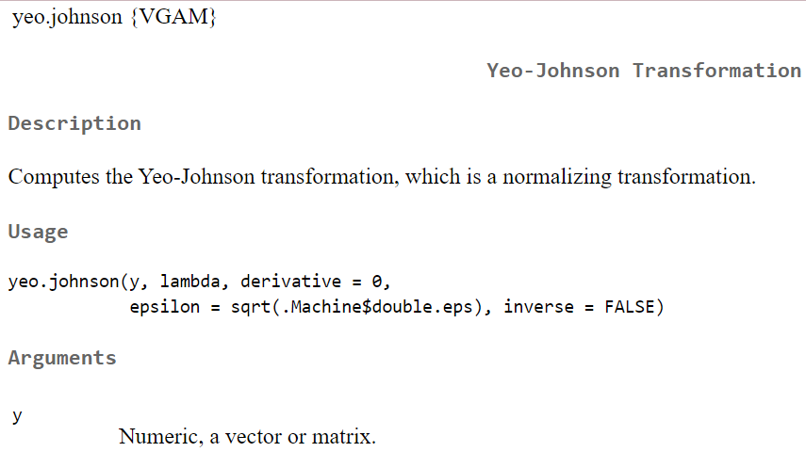
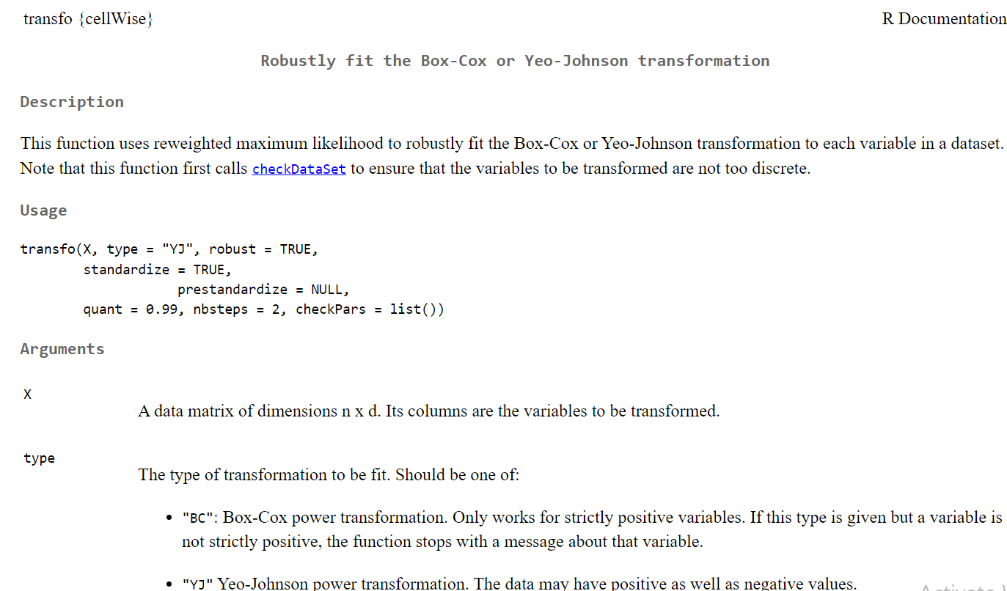
R function to conduct transformation

Slide 47

When to use Data Transformation
1. When the data is non-normal
One reason to use data transformation is when the data is non-normal. Non-normal data is data that does not follow a normal distribution, which is a symmetrical bell-shaped curve. Many statistical tests assume that the data is normal, so transforming non-normal data can help to make the results of these tests more accurate.
2. When the data is skewed
Another reason to use data transformation is when the data is skewed. Skewed data is data that is not evenly distributed, with most of the values clustered around one side of the distribution. Skewed data can often be transformed into a more normal distribution, which can be helpful for statistical testing.
3. When the data has outliers
Outliers are extreme values that are significantly different from the rest of the data. When outliers are present, they can often have a significant impact on the results of statistical tests. Therefore, it can be helpful to transform the data in order to reduce the impact of outliers on the results.

Slide 48
When to use Data Transformation
4. When you want to compare two or more groups of data
Another reason to use transformation is when you want to compare two or more groups of data. Some statistical tests require that the groups being compared have equal variance, which is a measure of how spread out the values are within a group. Transforming the data can often help to equalize the variance between groups, which can make comparisons more accurate.
5. When you want to stabilize variance over time
If you have data that was collected over time, you may want to use transformation in order to stabilize variance over time. Variance stabilization helps to ensure that any changes in the mean are not due simply to changes in variance over time, which can make interpretation of results more difficult

Slide 49
Summary of model diagnostics
 | Assumptions | Descriptions | Measurements | Potential actions
1 | Linearity Assumption | Relationships between all predictors and the response are linear | 1. residuals – fitted y values plot | Add high order terms or transform data
2 | Independence Assumption | Independence of observations | 1. Residuals vs predictors | Use other models than MLR
3 | Equal Variance Assumption | Error term has equal variance given any values of independent variables | Scale-Location plot. [square root of standardized residuals – fitted y values plot] Breusch-Pagan test (H0: no hetero) | Add high order terms or transform data
4 | Normality Assumption | Error term is normally distributed | Histogram Q-Q plot Kolmogorov-Smirnov test Shapiro-Wilk test | Add high order terms or transform data
5 | Multicollinearity | No perfect collinearity and non-zero variance of independent variables | Variance Inflation Factors (VIF) | - Drop one of the problematic variables - Combine colinear predictors to form a new predictor
6 | Outlier | Far away from other data points | Leverage values Cook’s distance | - Exclude them to see the effects on regression models - Check data points

Slide 50

Thank you
Questions OR Comments?
Slack channel: section2-course-documents
Email: qing.li2@uclagary.ca

